Slide 1
Eventful

Slide 2

Elevator Pitch
We are Yelp/Groupon for Social Events!
Imagine your best friend knows every events
near you. (S)he knows you well so she can
suggest you best events at any time or
situation. Eventful is the best friend that
you have in your cell phones that knows
the events around you and select
the best ones for you!

Slide 3
What we care about
PROBLEM
SOLUTION
People look for events near their work/home or even when they are traveling
There is no application that visualizes the Event location/information on the map
There is no application that suggests events based on your preference or past experiences
Eventful solves this problem by collecting event information and building a data base of people attending the events. It visualizes the events on the map so the information will be readily accessible for users. Data base of events and attendees can help Eventful learn what event suggest to each user.

Slide 4







Platform Architecture
Static Content Cloud Storage
Front End App
Dynamic Content Cloud SQL
Recommendation System
Cloud Load Balancing
Cloud DNS

Slide 5
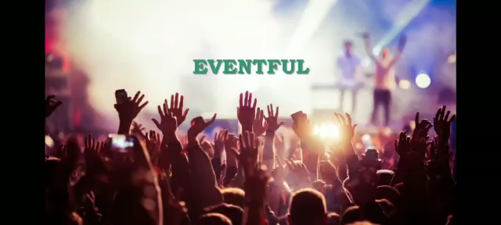
Our Product

Slide 6
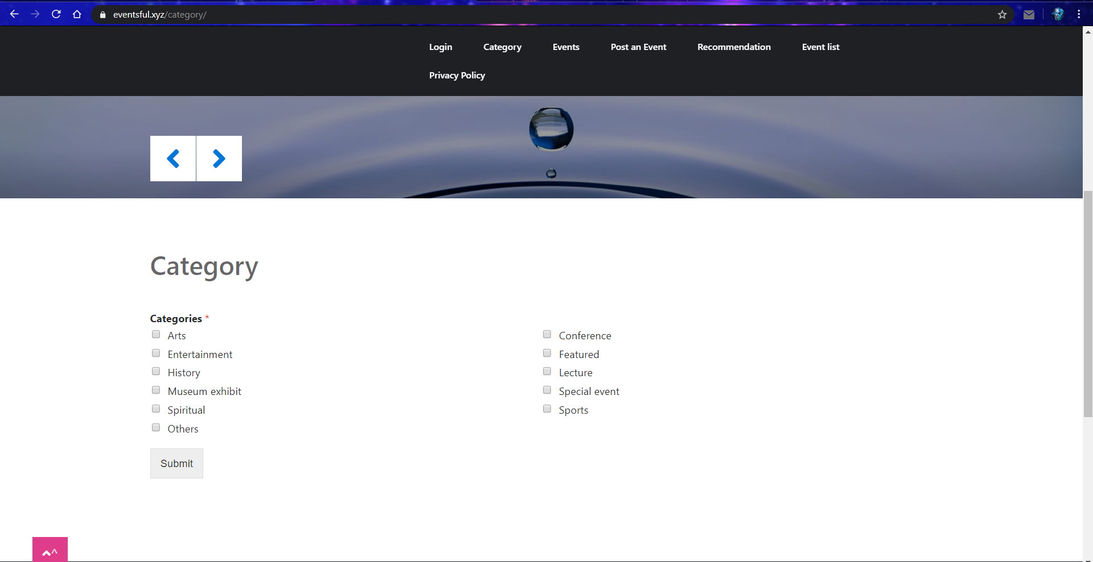
Category Selection Page

Slide 7
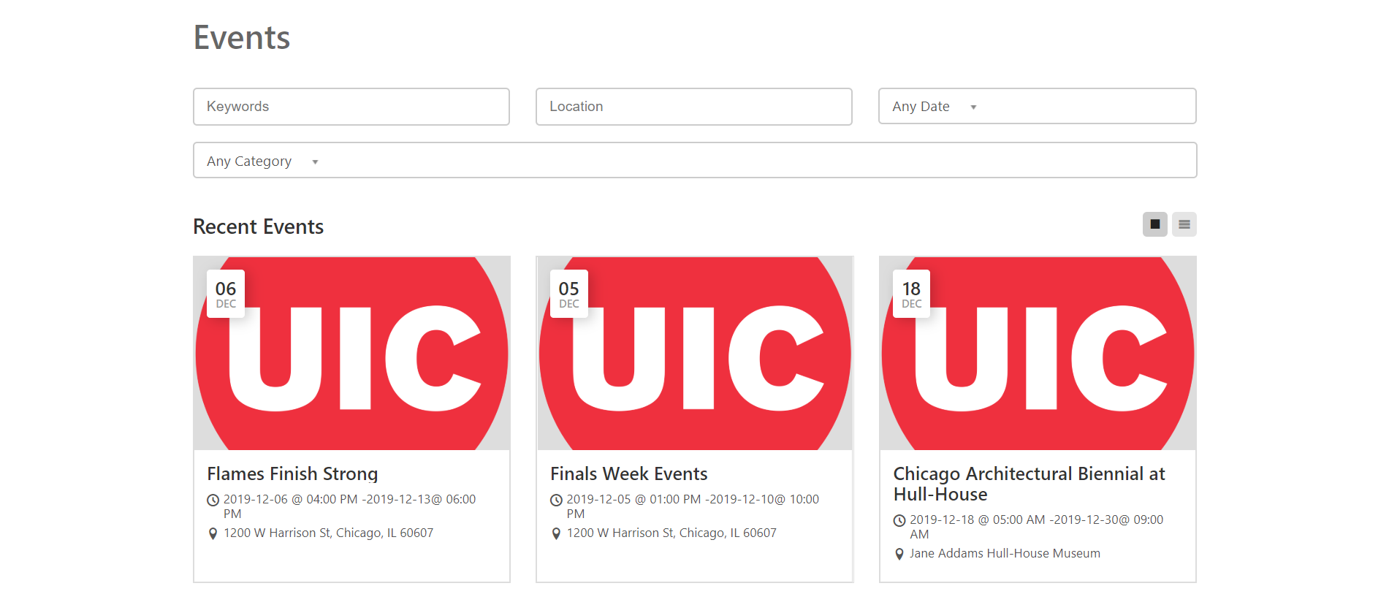
Events Selection Page

Slide 8
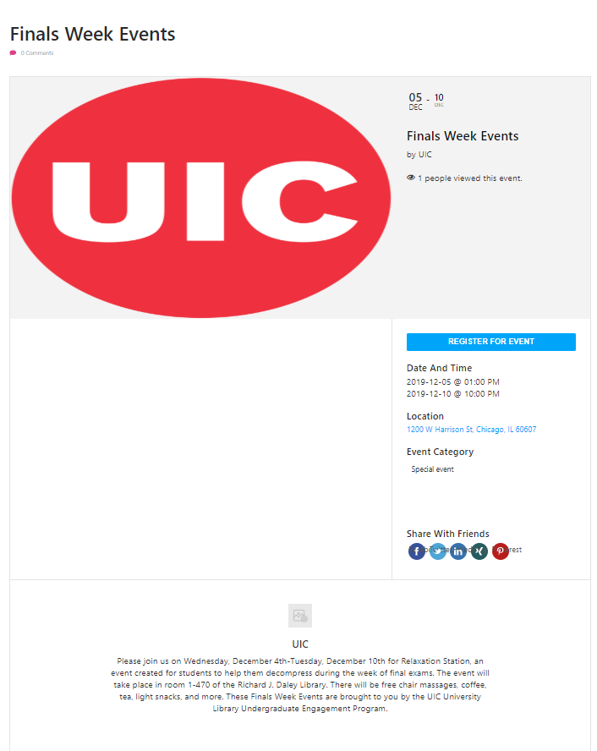
Events Page

Slide 9
Value Proposition
Users can search nearby events and you can modify the search with your preferences (i.e. Location, Price, Type)
The application visualizes the information of events on the map, this includes how many people are attending the event, price, and time.
It has a rating system whether you recommend an event. It affect the suggestions displayed to you or your friends.
Eventful provides information about your friends, what events they are going or your friends suggest you to go.

Slide 10
Competitors
Meetup
Only A list of Events
No filters for recommendations / No Personalized recommendation
Not displayed on the map
Only events that were created by an event organizers
Facebook
Only events that were created by an event organizers
Not displayed on the map

Slide 11

Who are our customers?
Any event organizer:
Pro Event Organizers,
Government, Nonprofit
Bar Owners, Music Bands

Slide 12

Who are our product Users?
Anyone who is looking to attend an event!
Usually in their twenties!

Slide 13
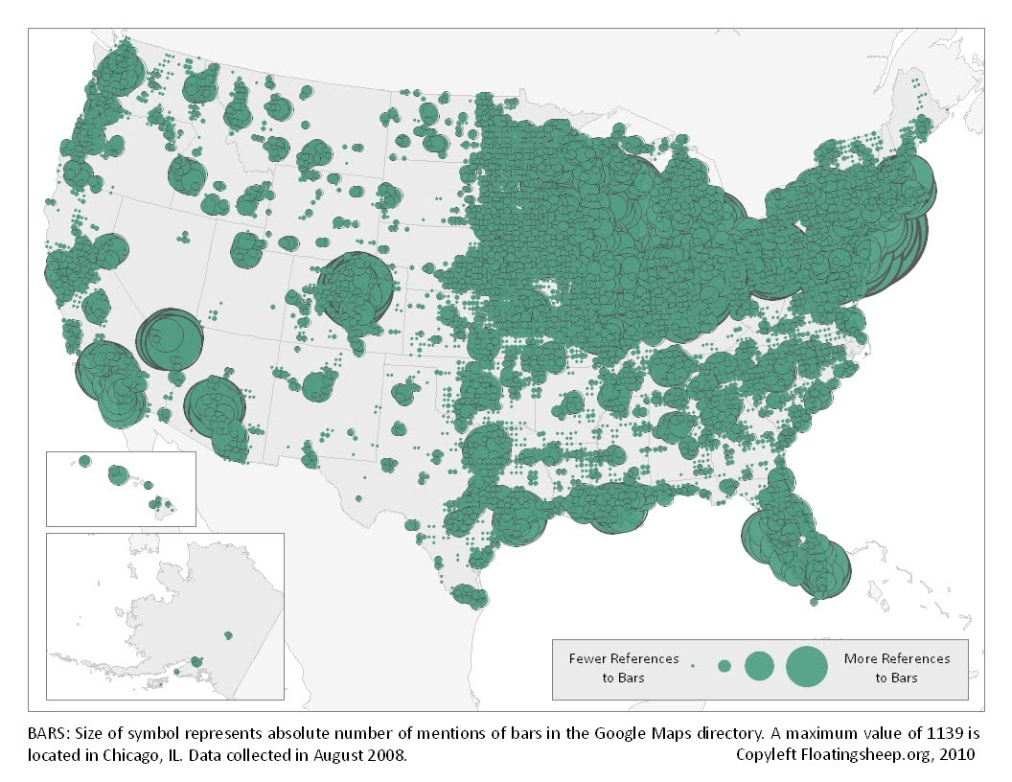
Market
We use bars as a Proxy
62602 bar in US
27 Billion Revenue Industry
Music Venues, Bars, Restaurants,
Public spaces
* Chicago has highest bars 1139!

Slide 14
Marketing
Two major ways for marketing:
Online advertisement on FB
Business cards at businesses
We estimate to grow our users by %20
Per month. Keep advertising and words of
mouth

Slide 15
Revenue Stream
Initially the goal is to collect a significant amount of users without making money, after stablishing it, we start collecting money in the following ways:
-Fee for having an event on the app (fixed $20 for bar happy hours)

Slide 16
Revenue System
First year:
10,000 customers using the app by the end of the year
The cost of acquisition:
Facebook add: $200000 for 5000 users
5000 Users, using suggestions, spread by word, business cards
Revenue: 2-3 Percent of Bars * Twice A week * Weeks per Year * Price (For now fixed $20)
50 * 2 * 52* 20 = 100,000
Cost of First year: $150,000 + 200000

Slide 17
Cover Chicago
Second year:
50,000 customers using the app by the end of the second year
The cost of acquisition:
Facebook add: $400000 for 10000 users
30000 Users, words of mouth, business cards
Revenue:
15 Percent of Bars * Twice A week * Weeks per Year * Price (For now fixed $20)
300 * 2 * 52* 20 = 600,000
Cost of Second year: $150,000 + 400000

Slide 18
Expand to 5 other cities
Third year:
300,000 customers using the app by the end of the third year
The cost of acquisition:
Facebook add: $1,000,000 for 25000 users
Rest of Users, using suggestions, spread by word, business cards
Revenue:
Number of Cities * 20 Percent of Bars * Twice A week * Weeks per Year
2000* 2 * 52* 20 = 4,000,000
Cost of Third year: $500,000 + 1,000,000

Slide 19
Expand to 20 cities
Forth year:
1,000,000 customers using the app by the end of the forth year
The cost of acquisition:
Facebook add: $2,000,000 for 50000 users
Rest of Users, using suggestions, spread by word, business cards
Revenue:
Number of Cities * 25 Percent of Bars * Twice A week * Weeks per Year
10000* 2 * 52* 20 = 20,000,000
Cost of Second year: $1,000,000 + 2,000,000

Slide 20
Cover United States
Fifth year:
4,000,000 customers using the app by the end of the fifth year
The cost of acquisition:
Facebook add: $4,000,000 for 1000000 users
Rest of Users, using suggestions, spread by word, business cards
Revenue:
25 Percent of Bars * Twice A week * Weeks per Year
30000* 2 * 52* 20 = 60,000,000
Cost of Second year: $2,000,000 + 4,000,000

Slide 21
Charts

Slide 22
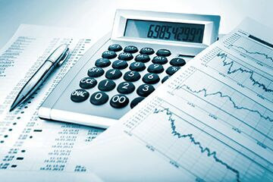
Investment
Based on our projections:
We need 1 million dollar for the first year
We also need 2 million dollars for the second year
We also need 2 million dollars for the third year
We will be profitable after the third year

Slide 23
Team
Vikas: Website front and back end and Scraping
Vishnu: Processing the data
Mohammad: business part and recommender system

